Slide 1
GOLDEN VALLEY GROUPS INITIATIVE SOCIETIES FAIR Sunday, 18th November 2018

Slide 2
GOLDEN VALLEY GROUPS INITIATIVE - ROLLING PRESENTATION
A SELECTION OF PHOTOS & REPORTS
FEATURING SOME OF THE COMMUNITY GROUPS
WHO OPERATE IN AND AROUND THE GOLDEN VALLEY
GOLDEN VALLEY PROBUS CLUB – NEXT
COMMUNITY FIRST
LET’S MOVE!
DORE COMMUNITY TRANSPORT
HEALTHWATCH HEREFORDSHIRE
FRIENDS OF THE ABBEY
HEREFORD SEARCHERS
GOLDEN VALLEY BOWLS CLUB
PETERCHURCH HUB

Slide 3
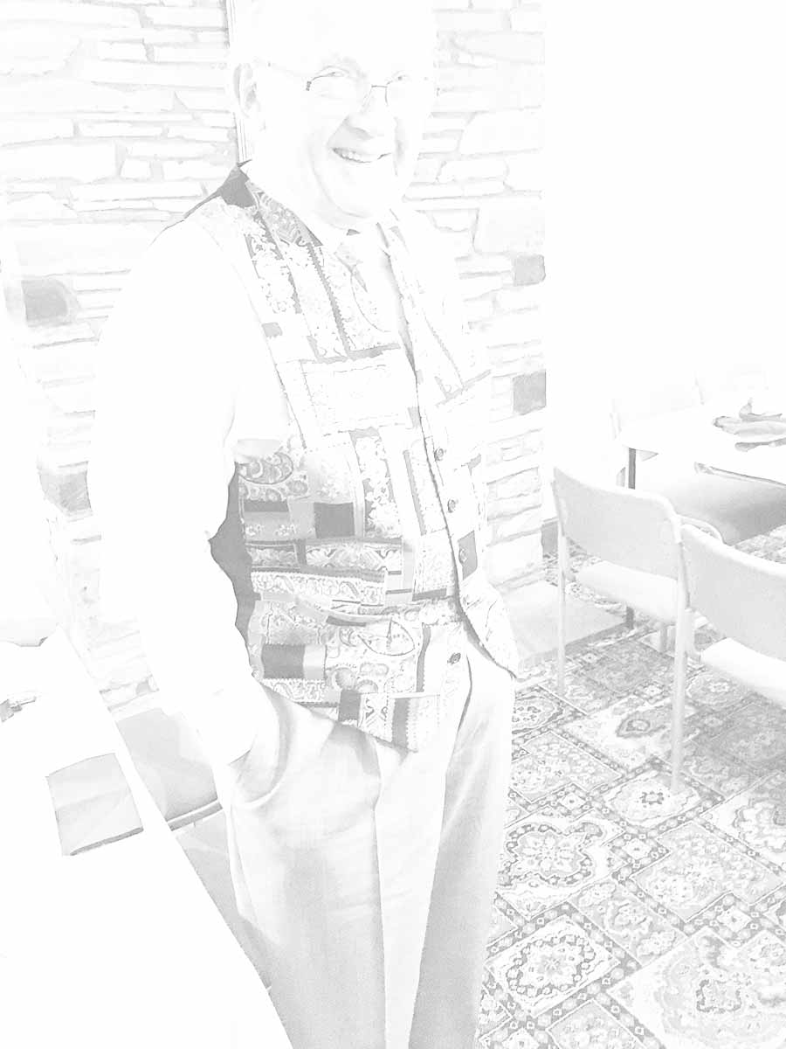
GOLDEN VALLEY PROBUS CLUB
A club for retired and semi-retired ‘Professional and Business Men’ (loosely defined).
One of the least formal and one of the most active Probus Clubs in the country.
Always at least 2 things happening every month.
11 Monthly Meetings + Christmas Lunch for Members only.
16 to 18 other events each year with Partners & Friends.

Slide 4
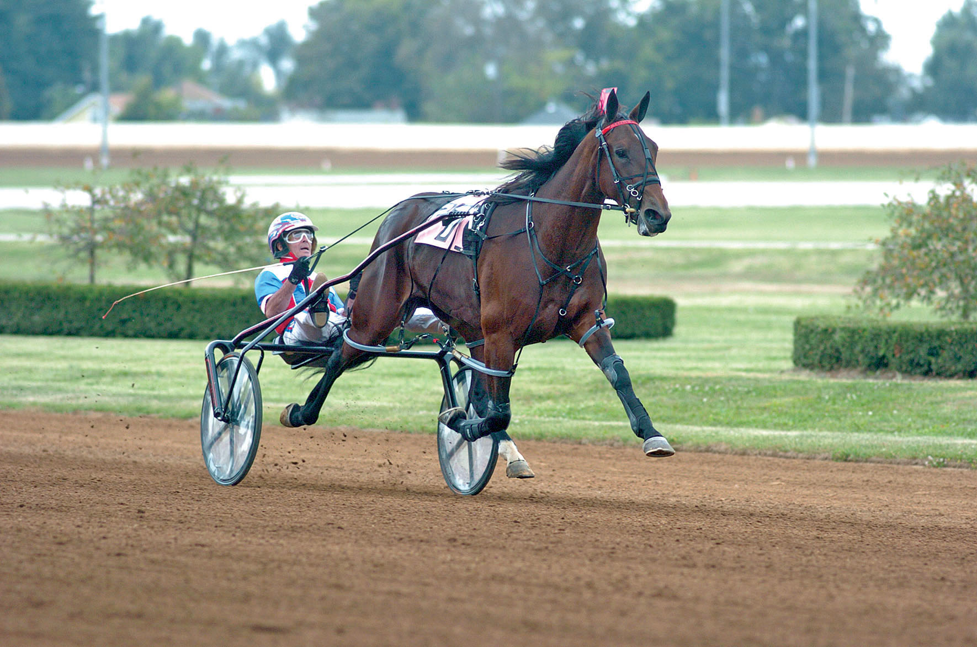
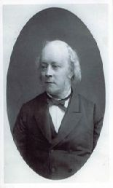
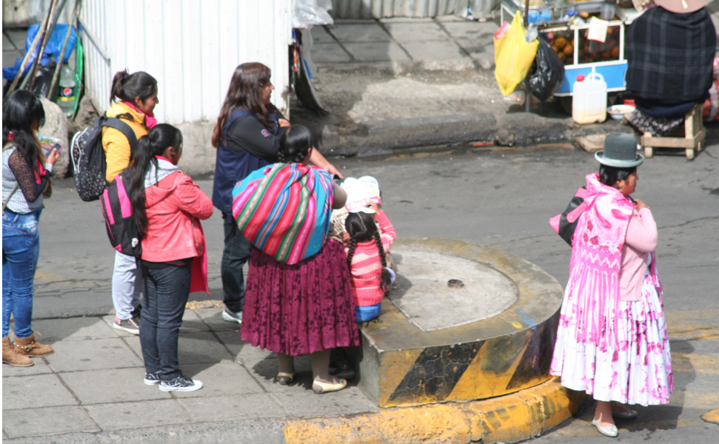

GOLDEN VALLEY PROBUS CLUB
11 Monthly Meetings with talks that are varied & interesting
Talks in 2017: 'Rowland Vaughan (who drowned the meadows)', 'Harness Racing', 'Rally Driving', 'Knee Replacement', 'Scot's Expedition to Antarctica', 'A cruise along the coast of Norway', 'Pre-history of The Black Mountains', 'Crossing the Isthmus by wet and dry canal', 'The Brecon Beacons National Park', 'Dr. Henry Graves Bull (a polymath in Victorian Hereford)' and 'Supporting Health & Well Being outside of normal NHS procedures’.
Talks in 2018: 'Heart Start (first aid after a heart attack)', 'Kosovo in 1999 (Real News)', 'Eight stringed instruments: Celtic harp, hammered dulcimer, tenor guitar, bouzouki, Appalachian mountain dulcimer, mandolin, tenor ukulele, and a koto-tampura-monochord hybrid', 'Bolivia', 'Electronics in Space', 'The Ten Pound Tourists who worked their way around Australia', 'Using my computer', 'Global strategic trends', 'A (Church of England) Priest in Portugal’, 'A Life of Crime (experiences as an 'at the scene' police officer)’ & ??.

Slide 5

GOLDEN VALLEY PROBUS CLUB
4 ANNUAL EVENTS
With Partners & Friends: Skittles Night in January,
Golf Day in May (Burghill), Ladies Night in August (Mary Powell’s)
Members only: Christmas Lunch
4 LUNCHES with Partners & Friends - always (so far) on a Sunday
The Temple Bar (Ewyas Harold) – March 2013, March 2015, March 2016, March 2017
Plas Derwyn (Abergavenny) – June 2013
The Railway Inn (Dinmore) – September 2013
White Haywood Farm (Craswall) – December 2013, December 2014, December 2015
December 2016, December 2017, December 2018
Garway Moon Inn – March 2014
Hedley Lodge (Belmont Abbey) – June 2014, June 2015
King of Prussia (near Abergavenny) – November 2014, October 2015
Park Hotel (Pandy) – May 2016, May 2017
Poston Mill (Peterchurch) – October 2016, October 2017, June 2018
Kilpeck Inn – April 2018
Loughpool Inn (Sellack) – October 2018
skittles

Slide 6
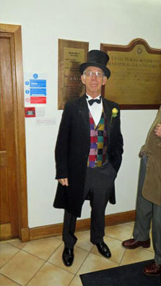
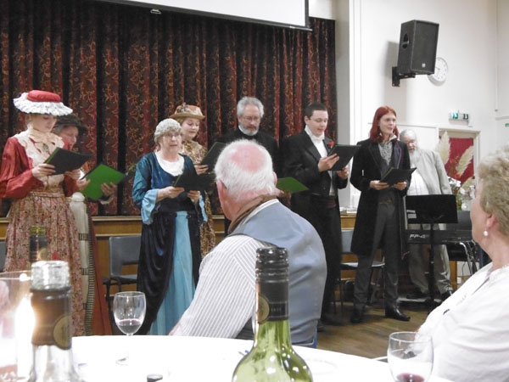
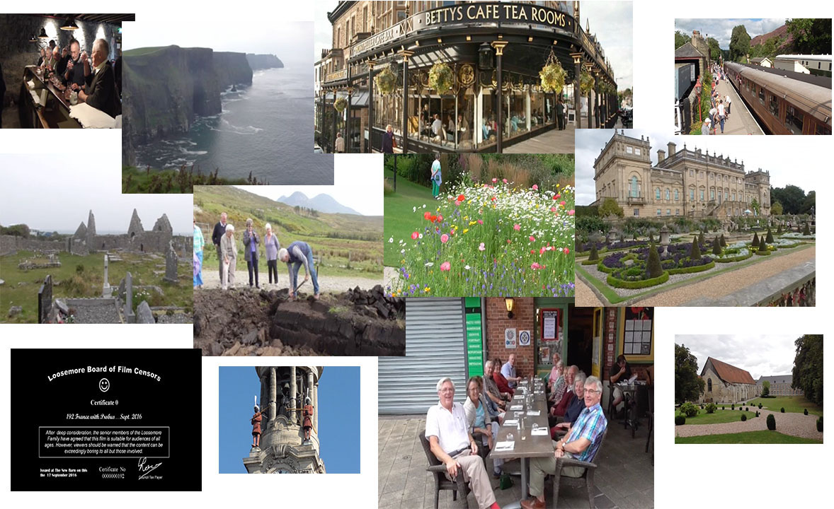
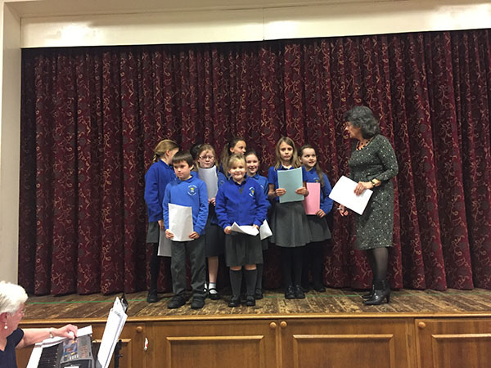
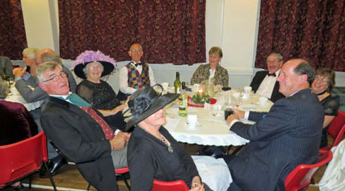
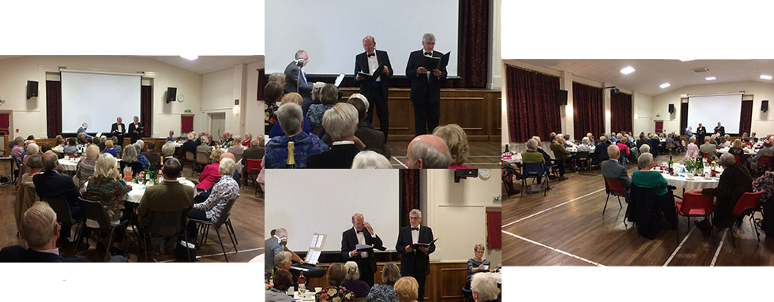
GOLDEN VALLEY PROBUS CLUB
PRESIDENT’S CHARITY EVENING EVERY 2 YEARS
2014
2016

Slide 7
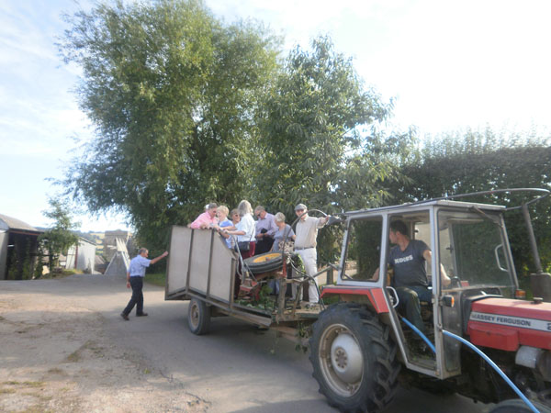
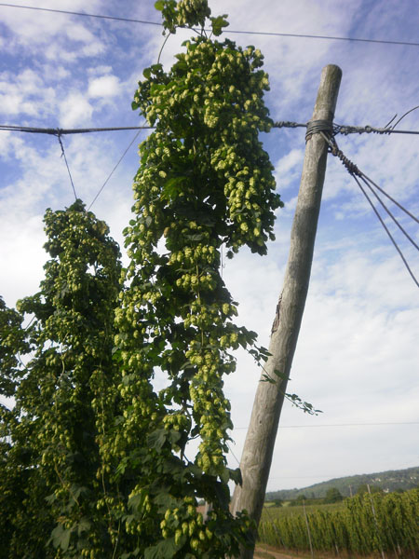
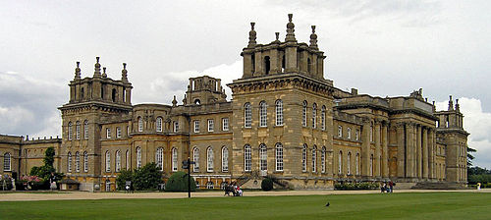
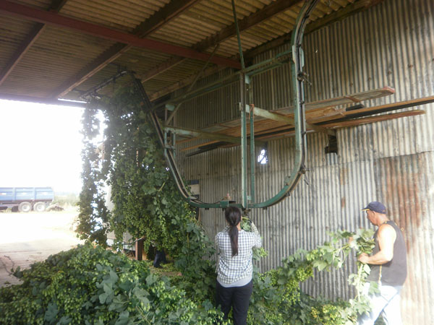
GOLDEN VALLEY PROBUS CLUB
6–9 OUTINGS EACH YEAR
2013 (9 outings) - Monkland Cheese Dairy, Worcester (city walk + The Elgar Museum), Gloucester & Warwick Railway + Bourton-on-the-Water, Sir Roy Strong’s Laskett Gardens, Aberglasney Gardens, Avebury (Manor & Ring), Church Farm (Weston Biggard), Bristol (M Shed Museum + SS Great Britain), Wye Valley Brewery
2014 (7 outings) - British Plastic Industry (Rhymney), Waterways Museum + Gloucester & Staverton Airport, National Memorial Arboretum (Alrewas), Fedwlydan Farm (Glasbury), Windsor Castle with Thames River Cruise, Westonbury Mill Water Gardens, Oakham Treasures Museum (Portbury)
2015 (9 outings) - Chase Distillery, Tewkesbury (Town & Abbey), Stonehenge & Woodhenge, Llanthony Court Farm, Sudeley Castle, Blenheim Palace, Hereford Cathedral Gardens & Magna Carta Exhibition, Mechanical Music Museum (Northleach) & Batsford Arboretum, Coventry Transport Museum
Visit to Church Farm, Weston Biggard, in September 2013
Blenheim Palace in July 2015

Slide 8
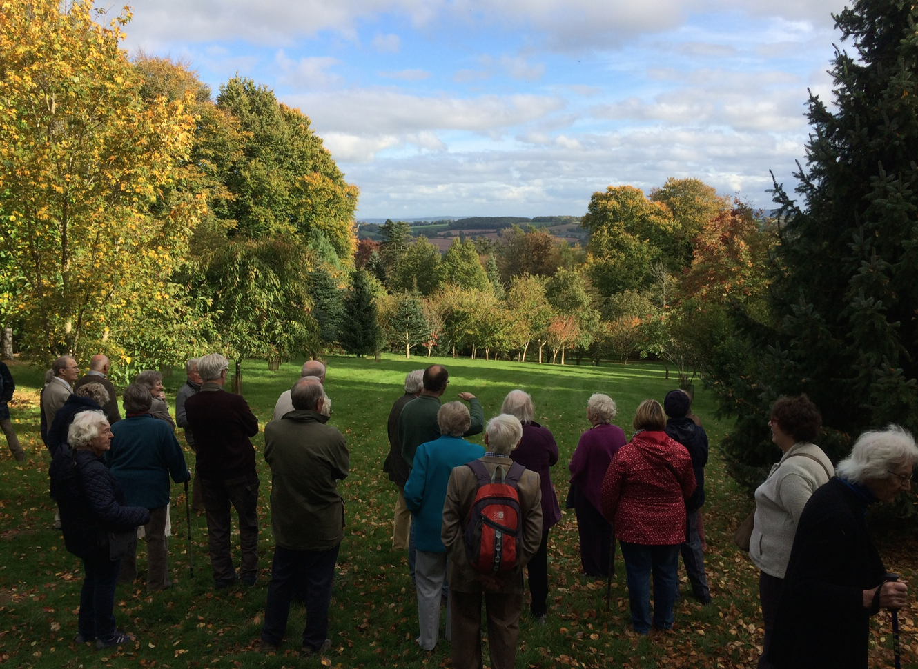
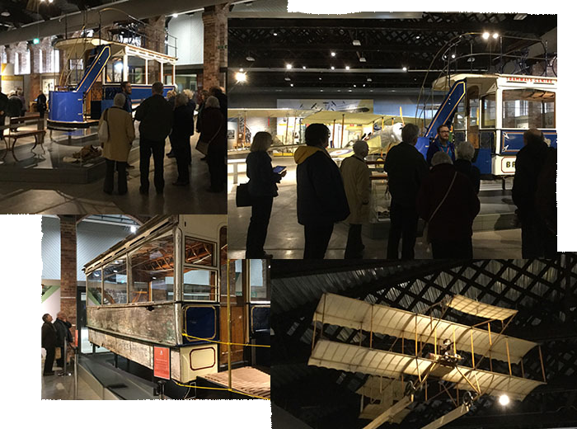
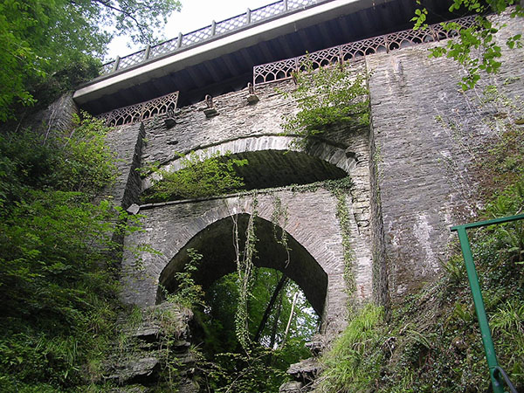
GOLDEN VALLEY PROBUS CLUB
6–9 OUTINGS EACH YEAR
2016 (6 outings) - Morgan Cars Malvern), Gloucester (Service Station & Regimental Museum), Bletchley Park, Aberystwyth (steam train from Devil’s Bridge), Ralph Court Gardens (Bromyard), Llancaiach Fawr Manor & The Royal Mint
2017 (7 outings) - Hereford Cider Museum, Knighton (Spaceguard & Offa’s Dyke Centre), Birmingham (Canal Cruise & Botanical Gardens),Trevase Farn, Wells (city & cathedral), British Ironworks Centre (Oswestry) & Chirk Castle, Hergest Croft Gardens (Kington), Bath Christmas Market
2018 (7 outings) - Aerospace Museum (Filton), Chavenage House (Tetbury), Bibury Trout Farm & Arlington, Elan Valley & Llysdinam Gardens, Coughton Park, Stockton Bury Gardens (near Leominster), Penderyn Distillery
Hergest Croft Gardens
(Kington) in October 2017
Devil’s Bridge
In May 2016
Aerospace Museum (Filton) in February 2018

Slide 9
GOLDEN VALLEY PROBUS CLUB
‘MINI BREAK’ HOLIDAY EVERY YEAR
for Members plus their Partners and Friends
2013 4 nights in Paris
2014 2 nights near Dublin, 4 nights in Galway
2015 5 nights in Jersey
2016 4 nights in Yorkshire
2017 5 nights near Colchester for visits in Suffolk
2018 4 nights in East Sussex

Slide 10
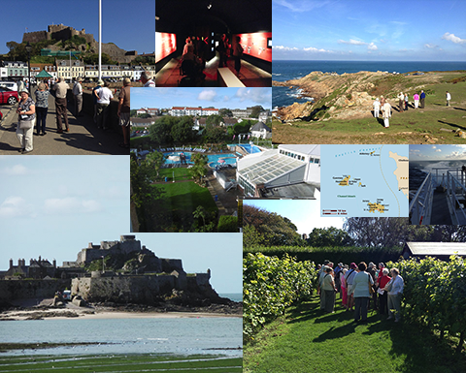
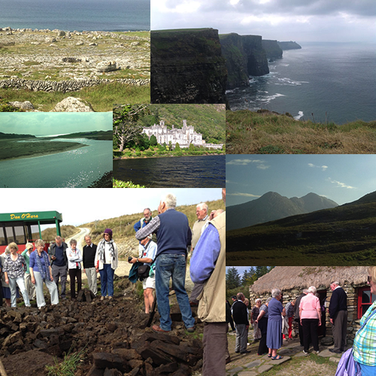
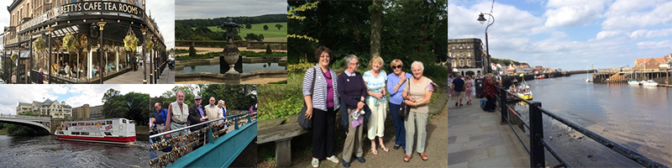
GOLDEN VALLEY PROBUS CLUB
Galway in 2014
Jersey in 2015
Yorkshire in 2016

Slide 11
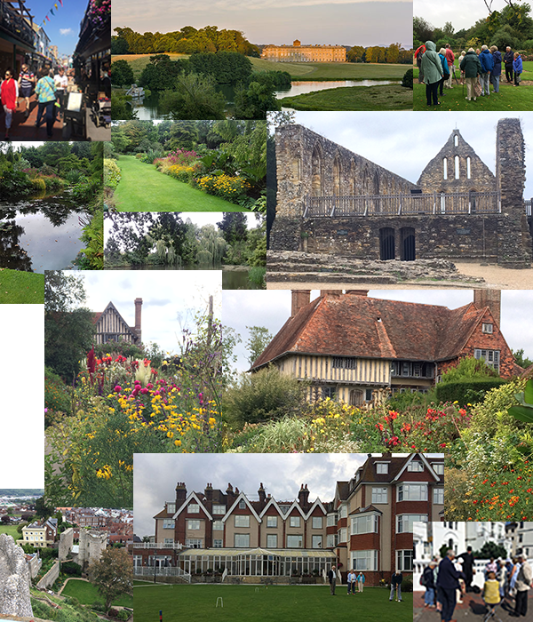
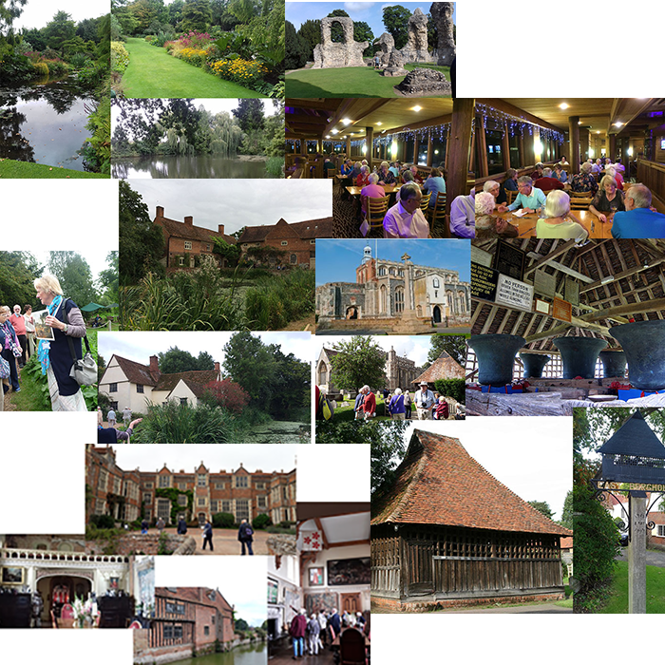
GOLDEN VALLEY PROBUS CLUB
Suffolk in 2017
East Sussex in 2018

Slide 12
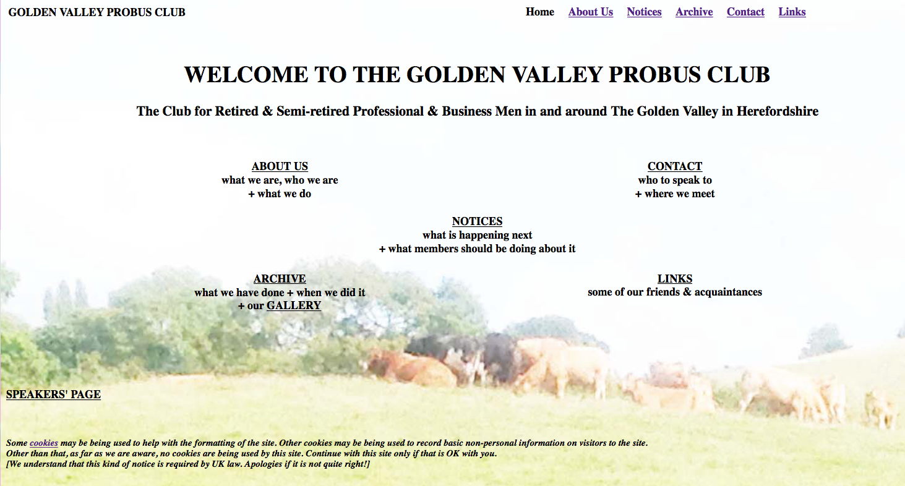
FOR MORE INFORMATION ABOUT
GOLDEN VALLEY PROBUS CLUB
SEE ITS WEB SITE AT
WWW.GOLDENVALLEYPROBUS.ORG.UK

Slide 13
GOLDEN VALLEY GROUPS INITIATIVE - ROLLING PRESENTATION
A SELECTION OF PHOTOS & REPORTS
FEATURING SOME OF THE COMMUNITY GROUPS
WHO OPERATE IN AND AROUND THE GOLDEN VALLEY
GOLDEN VALLEY PROBUS CLUB
COMMUNITY FIRST - NEXT
LET’S MOVE!
DORE COMMUNITY TRANSPORT
HEALTHWATCH HEREFORDSHIRE
FRIENDS OF THE ABBEY
HEREFORD SEARCHERS
GOLDEN VALLEY BOWLS CLUB
PETERCHURCH HUB

Slide 14

COMMUNITY FIRST
Extracts from “Running a village hall”
by Richard Timney
Village Hall Advisor

Slide 15
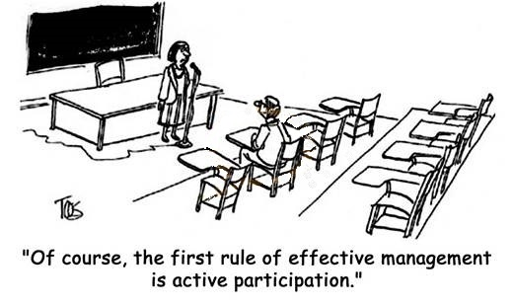
COMMUNITY FIRST

Slide 16
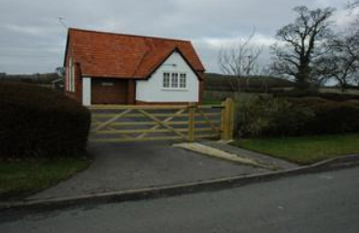
It should be easy…. Right??
COMMUNITY FIRST
The provision of a box in which public, social and other activities can take place.
Notes:
Aston Sommerville vh.
More than a box because of its position as one of the few remaining community assets in a rural community. Because it is run by local people for the use of local people.
They provide the venue for local people to stay in touch with each other, maintain or build community spirit and strength, help local people stay fit, learn or maintain interests.
What activities take place in village halls?

Slide 17
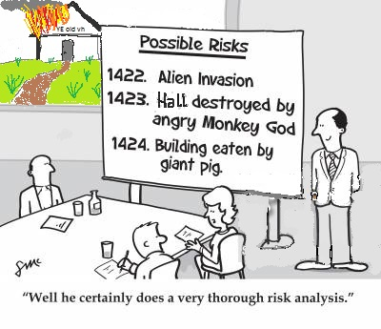
Not all halls are simple boxes. A number of rooms to hire. Kitchen Toilets Carparks Storage space
COMMUNITY FIRST
Extra considerations
Maintaining the hall
Fundraising
Data Protection
Protection of vulnerable adults
Finding volunteers
Promoting the hall
Powers of the Committee
- venue not activities
- legal and in line with duty
Community expectations
Neighbours
Finding the time
Notes:
What other spaces do some halls have?

Slide 18
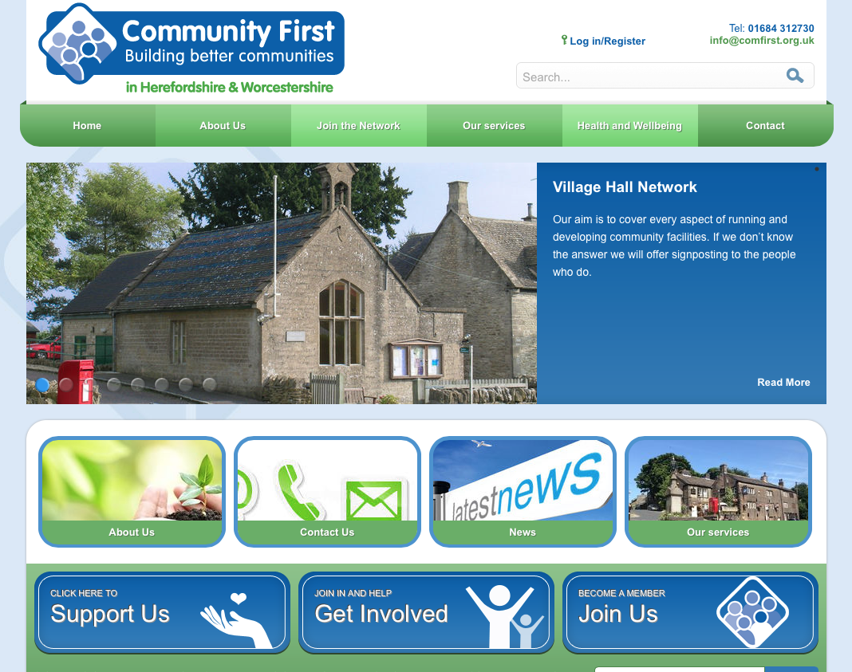
FOR MORE INFORMATION ABOUT
COMMUNITY FIRST
SEE ITS WEB SITE AT
WWW.COMFIRST.ORG.UK

Slide 19
GOLDEN VALLEY GROUPS INITIATIVE - ROLLING PRESENTATION
A SELECTION OF PHOTOS & REPORTS
FEATURING SOME OF THE COMMUNITY GROUPS
WHO OPERATE IN AND AROUND THE GOLDEN VALLEY
GOLDEN VALLEY PROBUS CLUB
COMMUNITY FIRST
LET’S MOVE! – NEXT
DORE COMMUNITY TRANSPORT
HEALTHWATCH HEREFORDSHIRE
FRIENDS OF THE ABBEY
HEREFORD SEARCHERS
GOLDEN VALLEY BOWLS CLUB
PETERCHURCH HUB

Slide 20


Slide 21
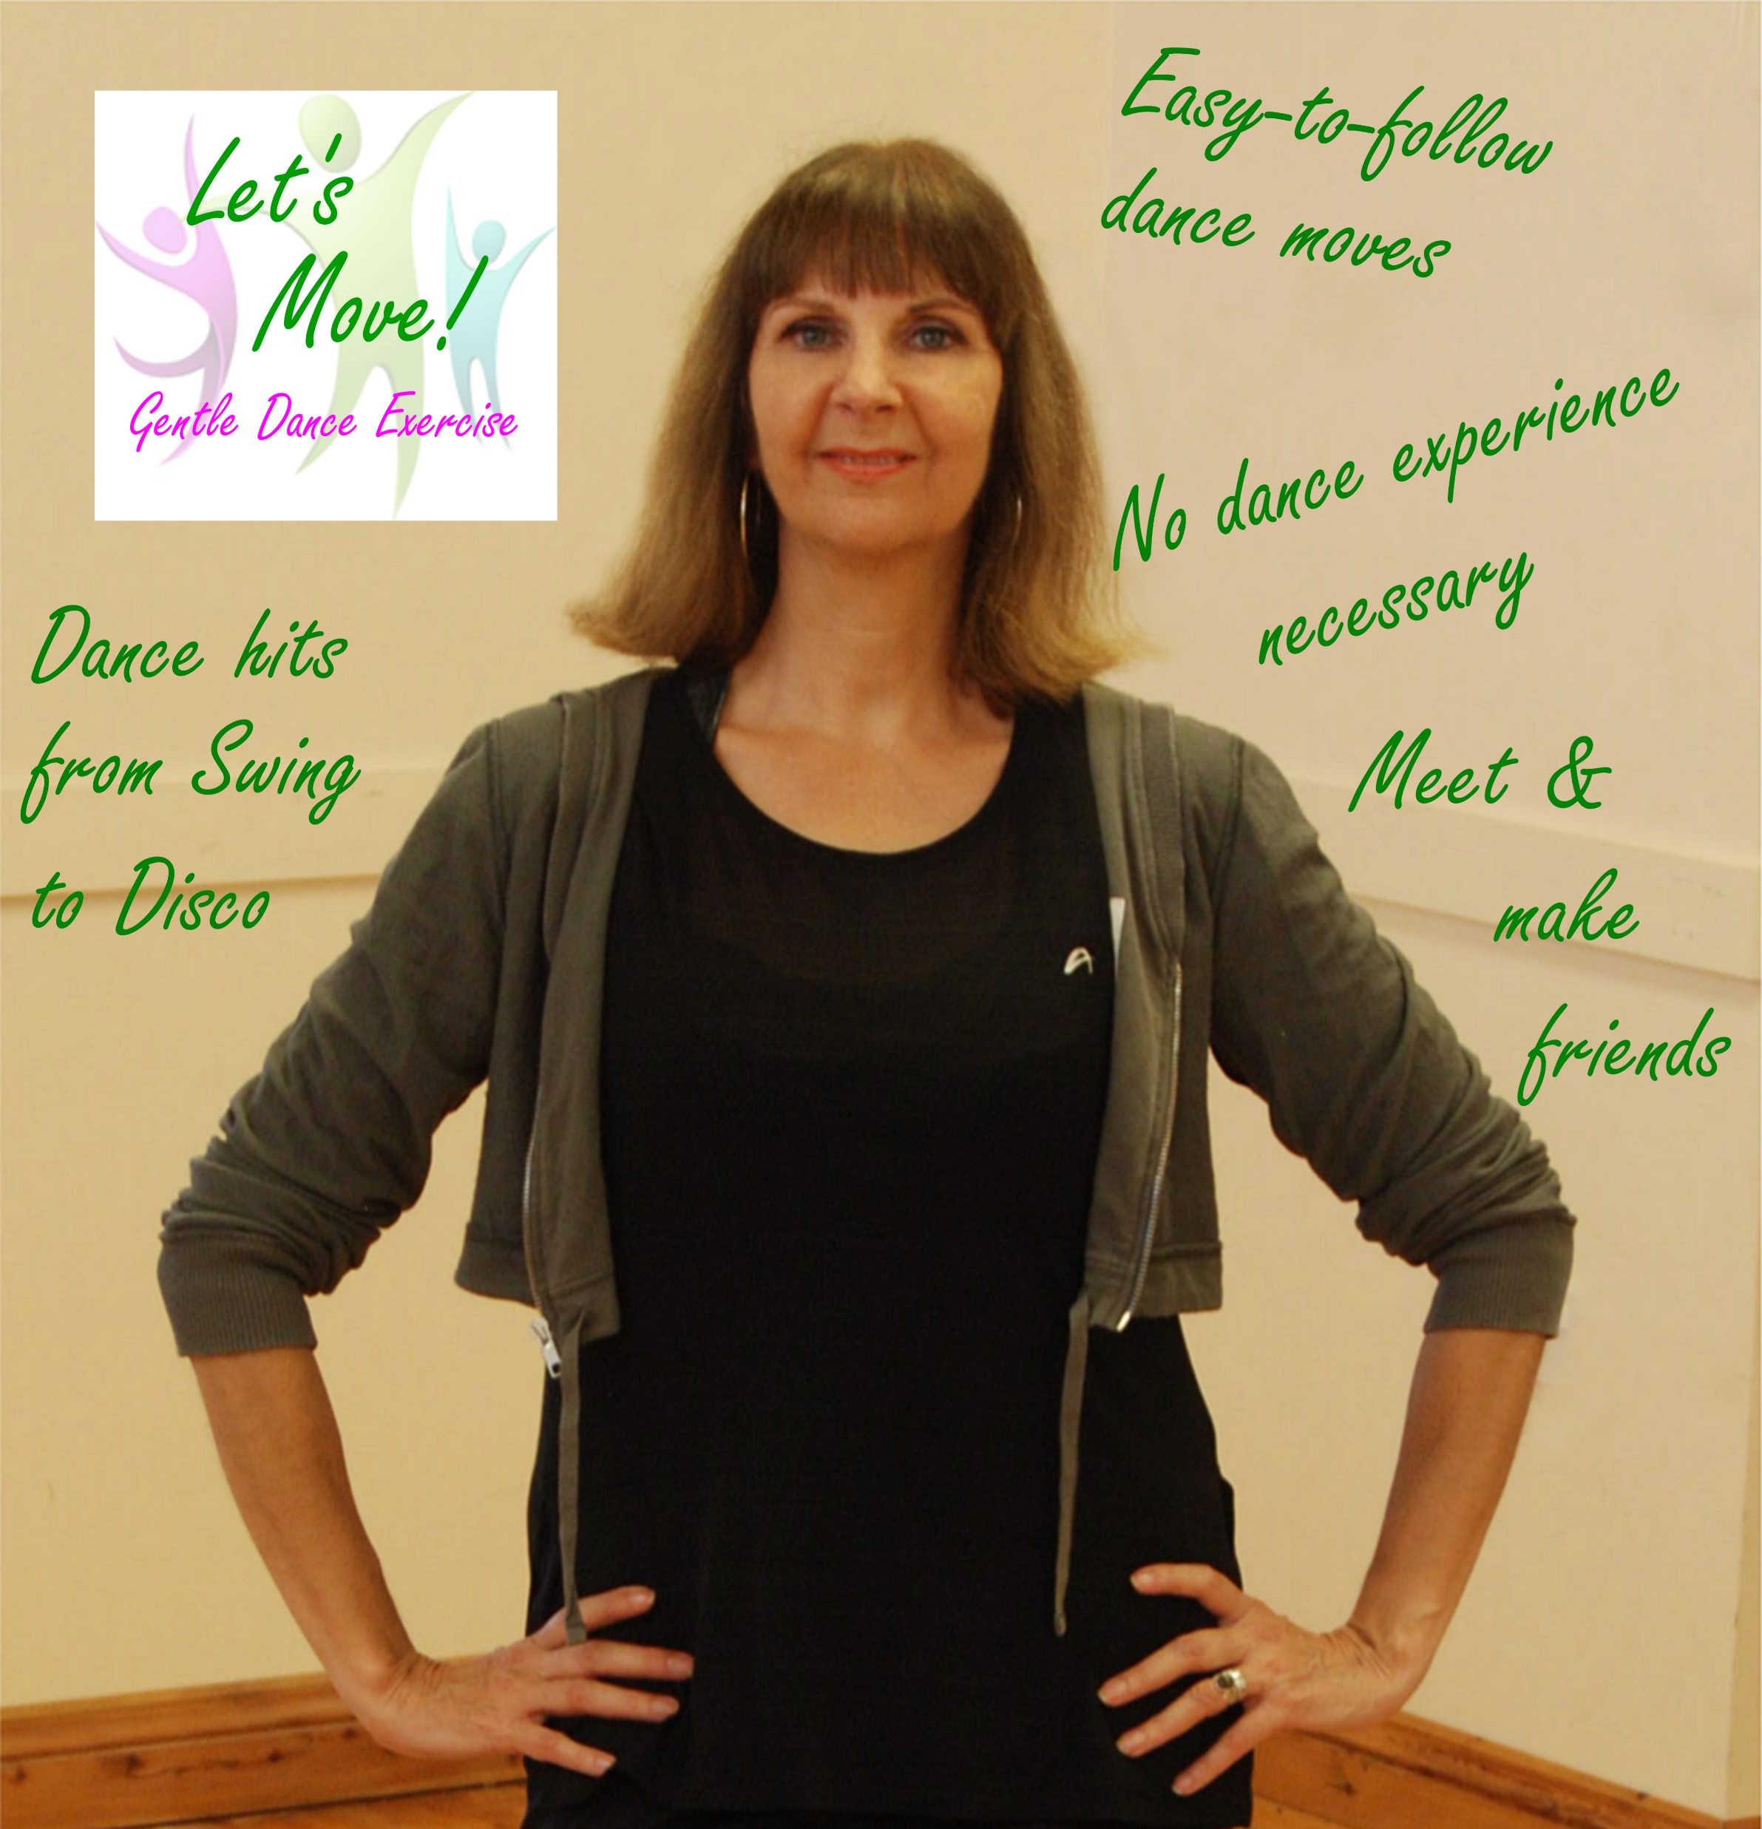

Slide 22


LET’S MOVE! has sessions on Thursdays at Peterchurch Village Hall (2.00-2.45pm)
Let’s Move! is run by Abbie Mason who also runs
ALANYA DANCE which can be found on Facebook.

Slide 23
GOLDEN VALLEY GROUPS INITIATIVE - ROLLING PRESENTATION
A SELECTION OF PHOTOS & REPORTS
FEATURING SOME OF THE COMMUNITY GROUPS
WHO OPERATE IN AND AROUND THE GOLDEN VALLEY
GOLDEN VALLEY PROBUS CLUB
COMMUNITY FIRST
LET’S MOVE!
DORE COMMUNITY TRANSPORT – NEXT
HEALTHWATCH HEREFORDSHIRE
FRIENDS OF THE ABBEY
HEREFORD SEARCHERS
GOLDEN VALLEY BOWLS CLUB
PETERCHURCH HUB

Slide 24
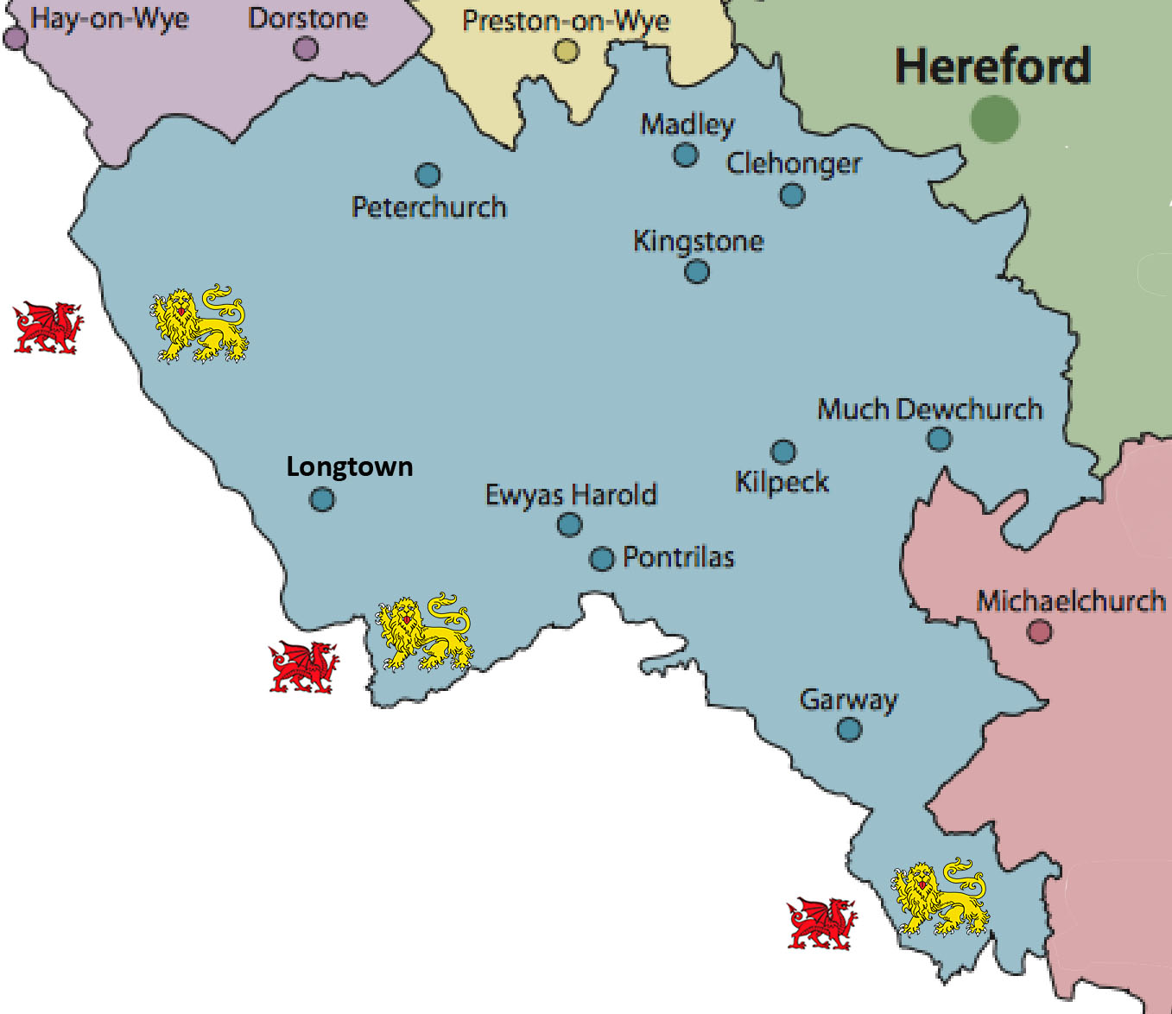
DORE COMMUNITY TRANSPORT
The main Community Transport charity operating in South-West Herefordshire.

Slide 25
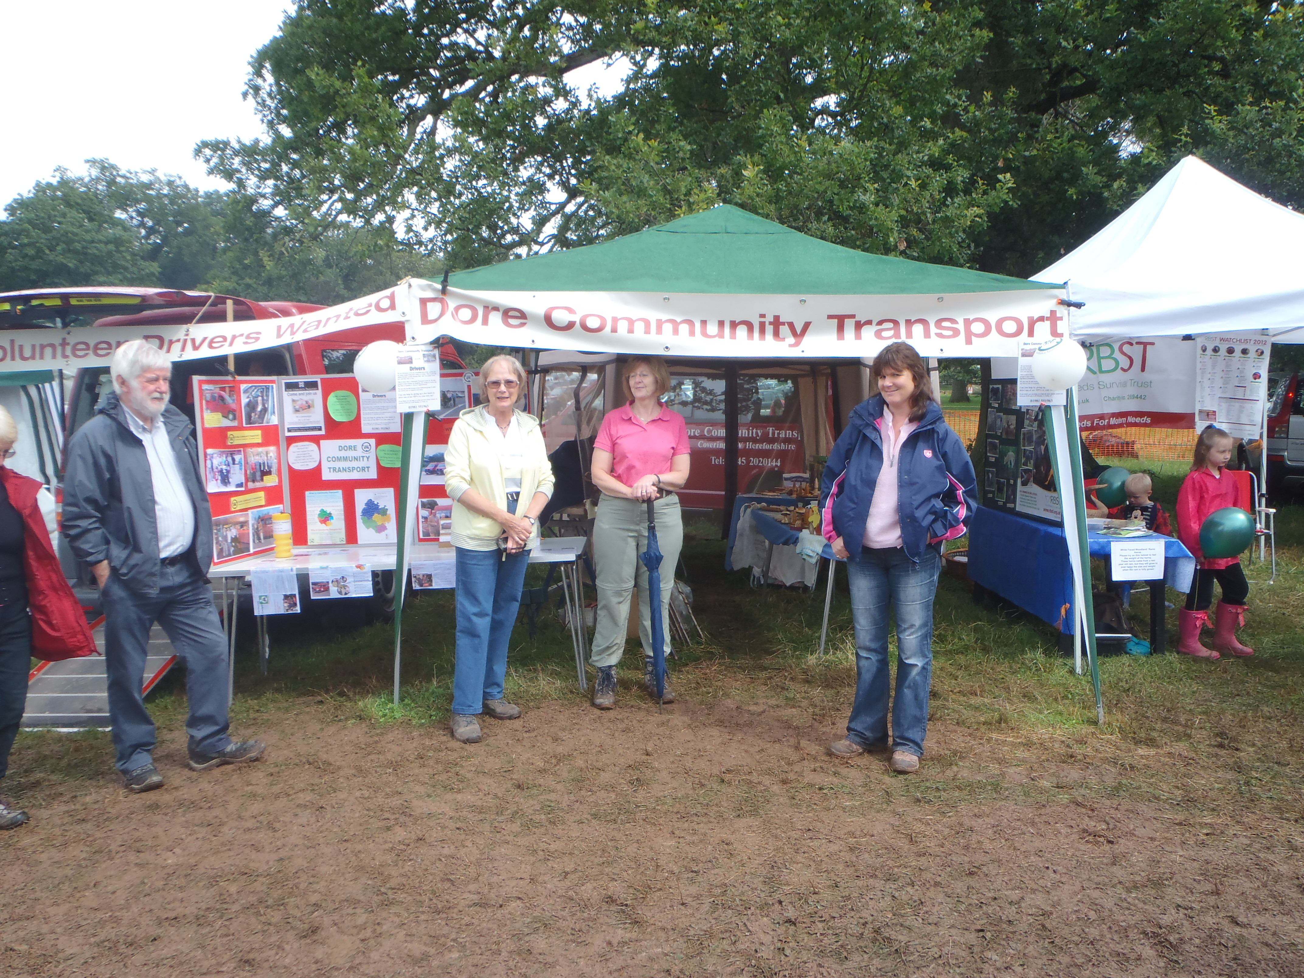
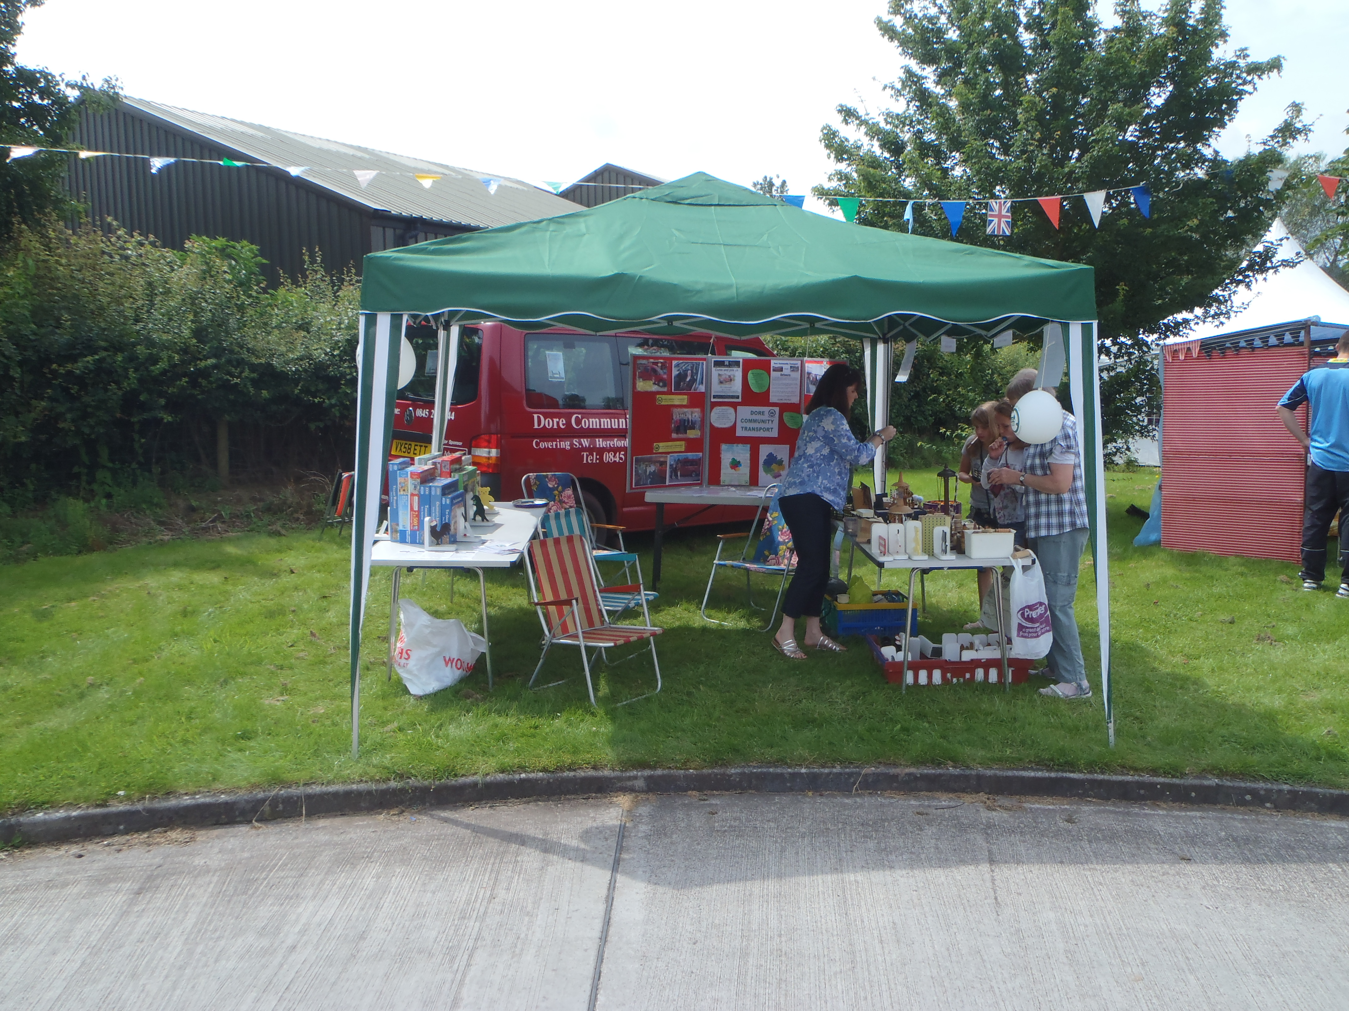
DORE COMMUNITY TRANSPORT
Dore is managed by hands-on volunteer Trustees with only
a very small team of administrators.
Dore CT is mostly financed by its modest charges, a grant
from Local Government, donations received (Thank You!),
and its occasional fund-raising events.

Slide 26
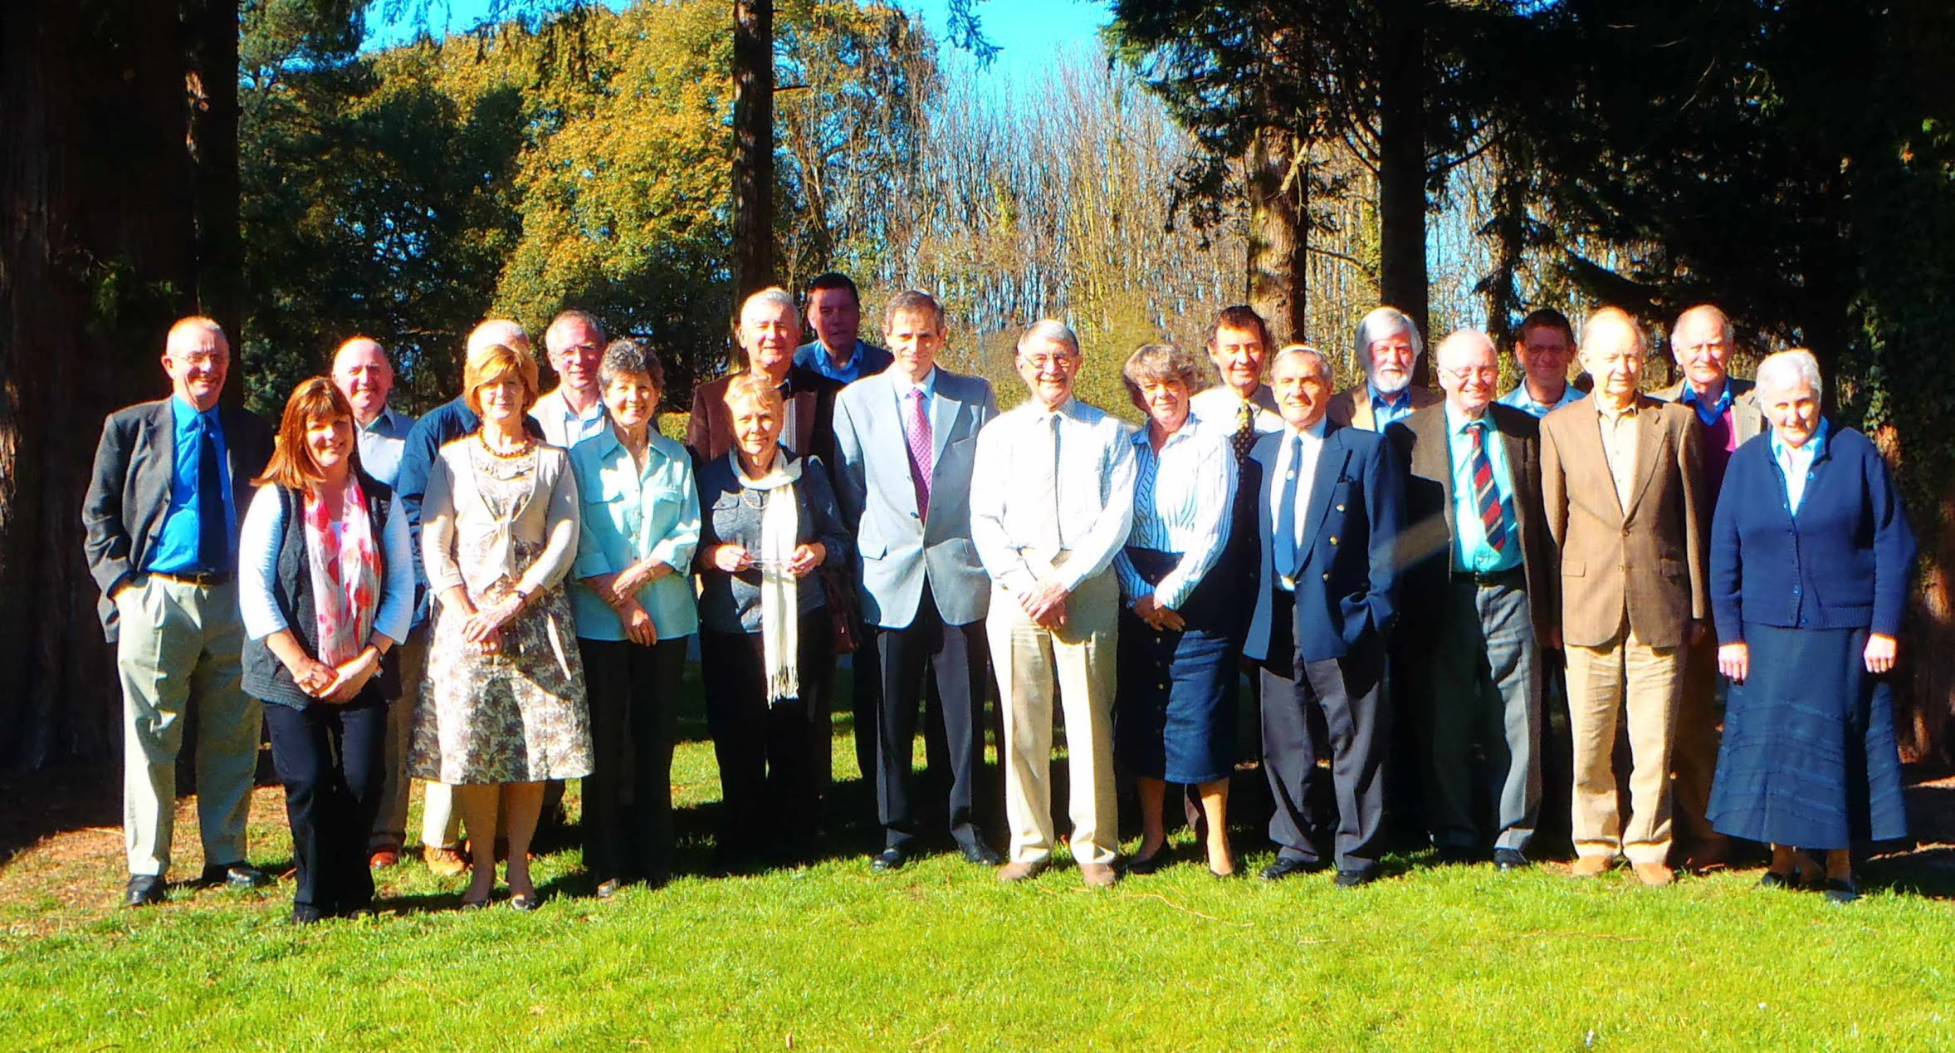
DORE COMMUNITY TRANSPORT
Dore CT has a fantastic group of volunteer drivers. This is one of those kinds of volunteering that is really rewarding because you can see that it really makes a difference to people. If you can, why not join them?!

Slide 27
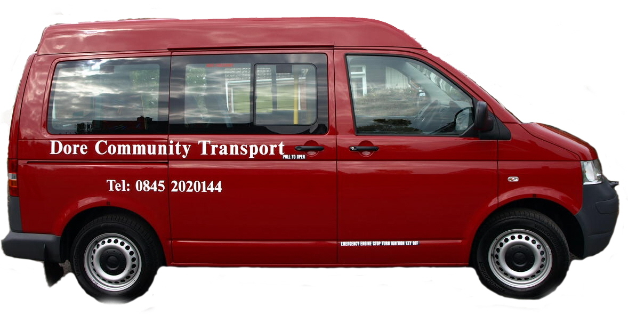
DORE COMMUNITY TRANSPORT
Our team of volunteers
is growing – but so is
the demand for our
services. That demand
Is likely to grow further
as more people realise that we
are not here just to take people to hospital appointments.
We carry individuals and groups, old and young, for one-off trips
or regular journeys, to all sorts of destinations.
Volunteers who want to drive our
multi-person wheelchair-carrying vehicles
receive training to do so. Many volunteers
drive their own cars (and are reimbursed).

Slide 28
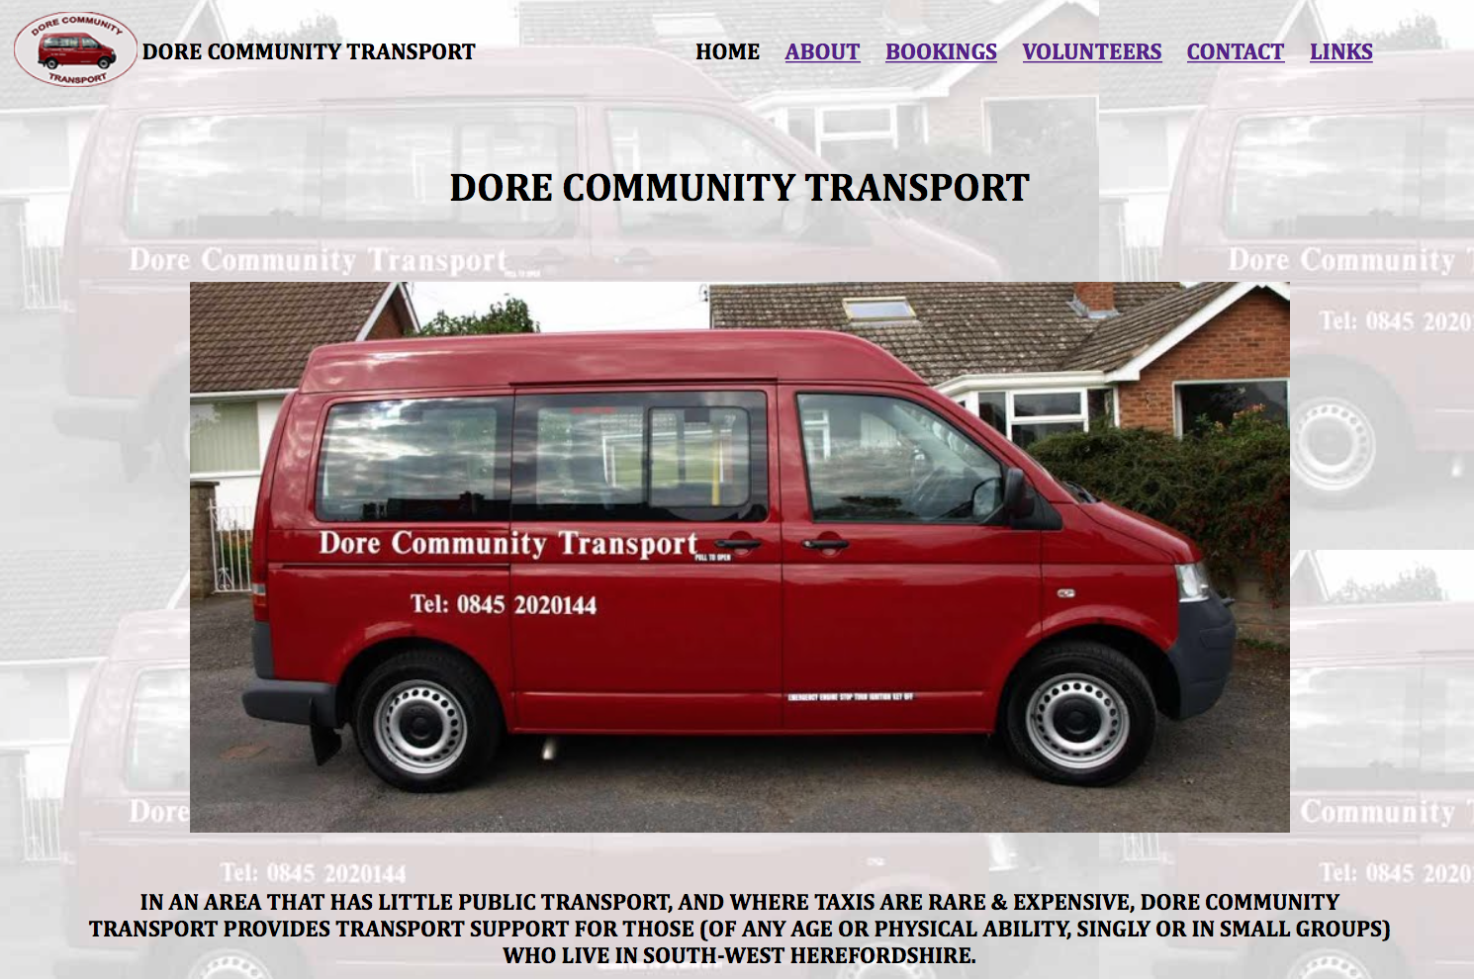
To find out more about DORE COMMUNITY TRANSPORT call 0845-2020-144 (Monday to Friday; 9 am to 12 noon) or visit our web site at www.DoreCommunityTransport.org.uk

Slide 29
GOLDEN VALLEY GROUPS INITIATIVE - ROLLING PRESENTATION
A SELECTION OF PHOTOS & REPORTS
FEATURING SOME OF THE COMMUNITY GROUPS
WHO OPERATE IN AND AROUND THE GOLDEN VALLEY
GOLDEN VALLEY PROBUS CLUB
COMMUNITY FIRST
LET’S MOVE!
DORE COMMUNITY TRANSPORT
HEALTHWATCH HEREFORDSHIRE - NEXT
FRIENDS OF THE ABBEY
HEREFORD SEARCHERS
GOLDEN VALLEY BOWLS CLUB
PETERCHURCH HUB

Slide 30


Slide 31
GOLDEN VALLEY GROUPS INITIATIVE - ROLLING PRESENTATION
A SELECTION OF PHOTOS & REPORTS
FEATURING SOME OF THE COMMUNITY GROUPS
WHO OPERATE IN AND AROUND THE GOLDEN VALLEY
GOLDEN VALLEY PROBUS CLUB
COMMUNITY FIRST
LET’S MOVE!
DORE COMMUNITY TRANSPORT
HEALTHWATCH HEREFORDSHIRE
FRIENDS OF THE ABBEY - NEXT
HEREFORD SEARCHERS
GOLDEN VALLEY BOWLS CLUB
PETERCHURCH HUB

Slide 32
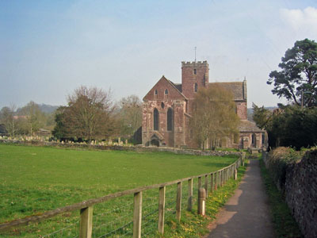
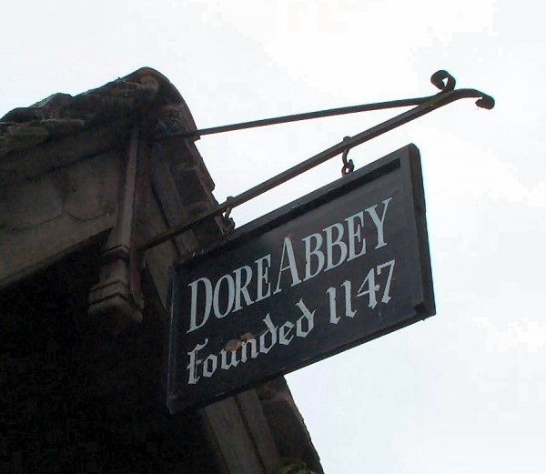
FRIENDS OF DORE ABBEY
DORE ABBEY
A PLACE OF WORSHIP
A VENUE FOR THE ARTS,
CRAFTS & MUSIC
A NATIONAL TREASURE

Slide 33
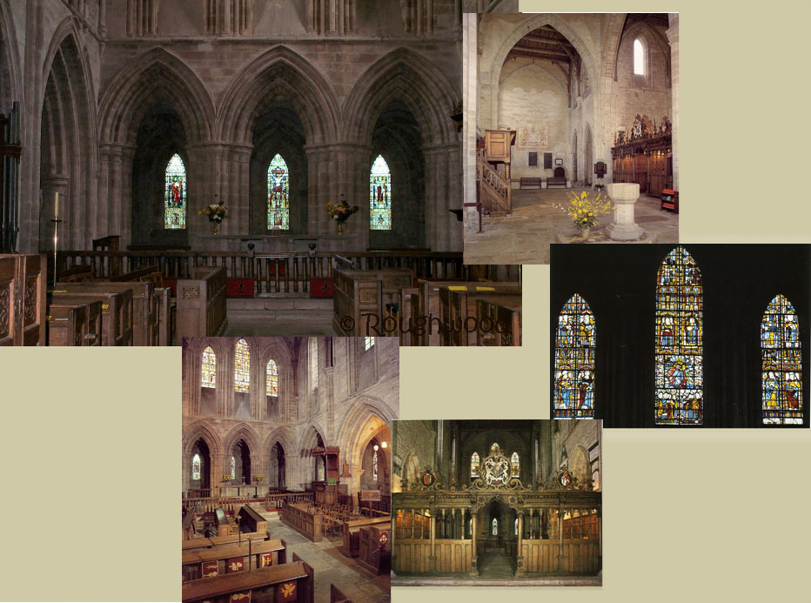
FRIENDS OF DORE ABBEY
A MODERN PARISH CHURCH
AN ANCIENT BUILDING

Slide 34
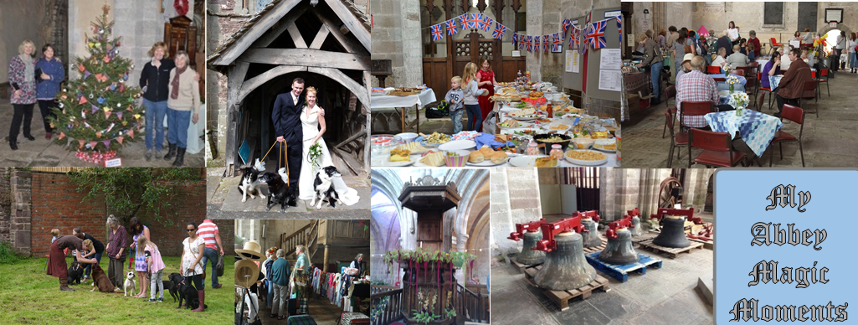
FRIENDS OF DORE ABBEY
A PLACE WITH MEMORIES
A PLACE FOR MEMORIES

Slide 35
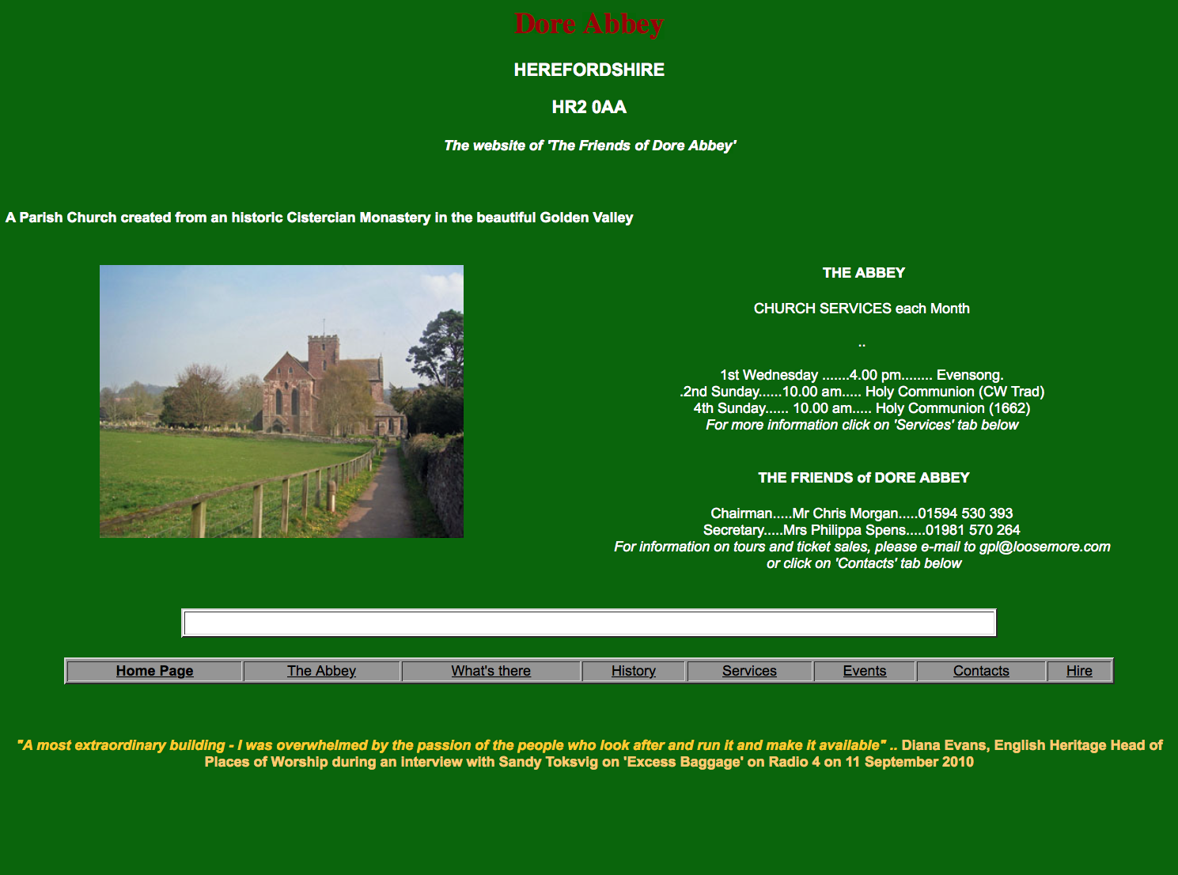
FRIENDS OF DORE ABBEY
Information on Dore Abbey’s services & activities
can be found at www.DoreAbbey.org.uk

Slide 36
GOLDEN VALLEY GROUPS INITIATIVE - ROLLING PRESENTATION
A SELECTION OF PHOTOS & REPORTS
FEATURING SOME OF THE COMMUNITY GROUPS
WHO OPERATE IN AND AROUND THE GOLDEN VALLEY
GOLDEN VALLEY PROBUS CLUB
COMMUNITY FIRST
LET’S MOVE!
DORE COMMUNITY TRANSPORT
HEALTHWATCH HEREFORDSHIRE
FRIENDS OF THE ABBEY
HEREFORD SEARCHERS - NEXT
GOLDEN VALLEY BOWLS CLUB
PETERCHURCH HUB

Slide 37
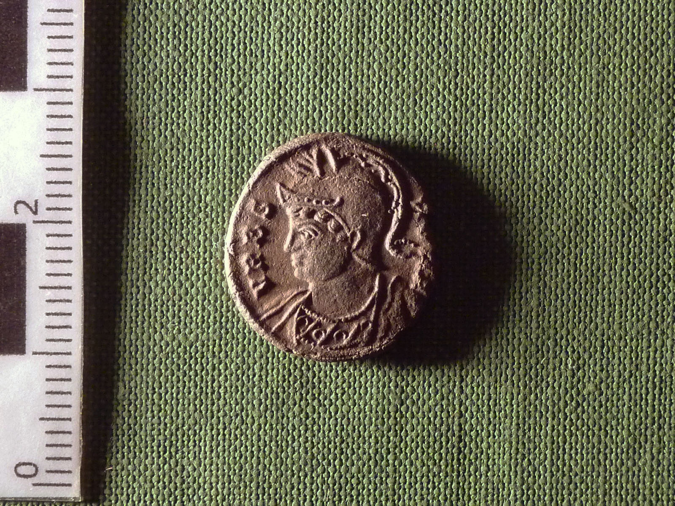
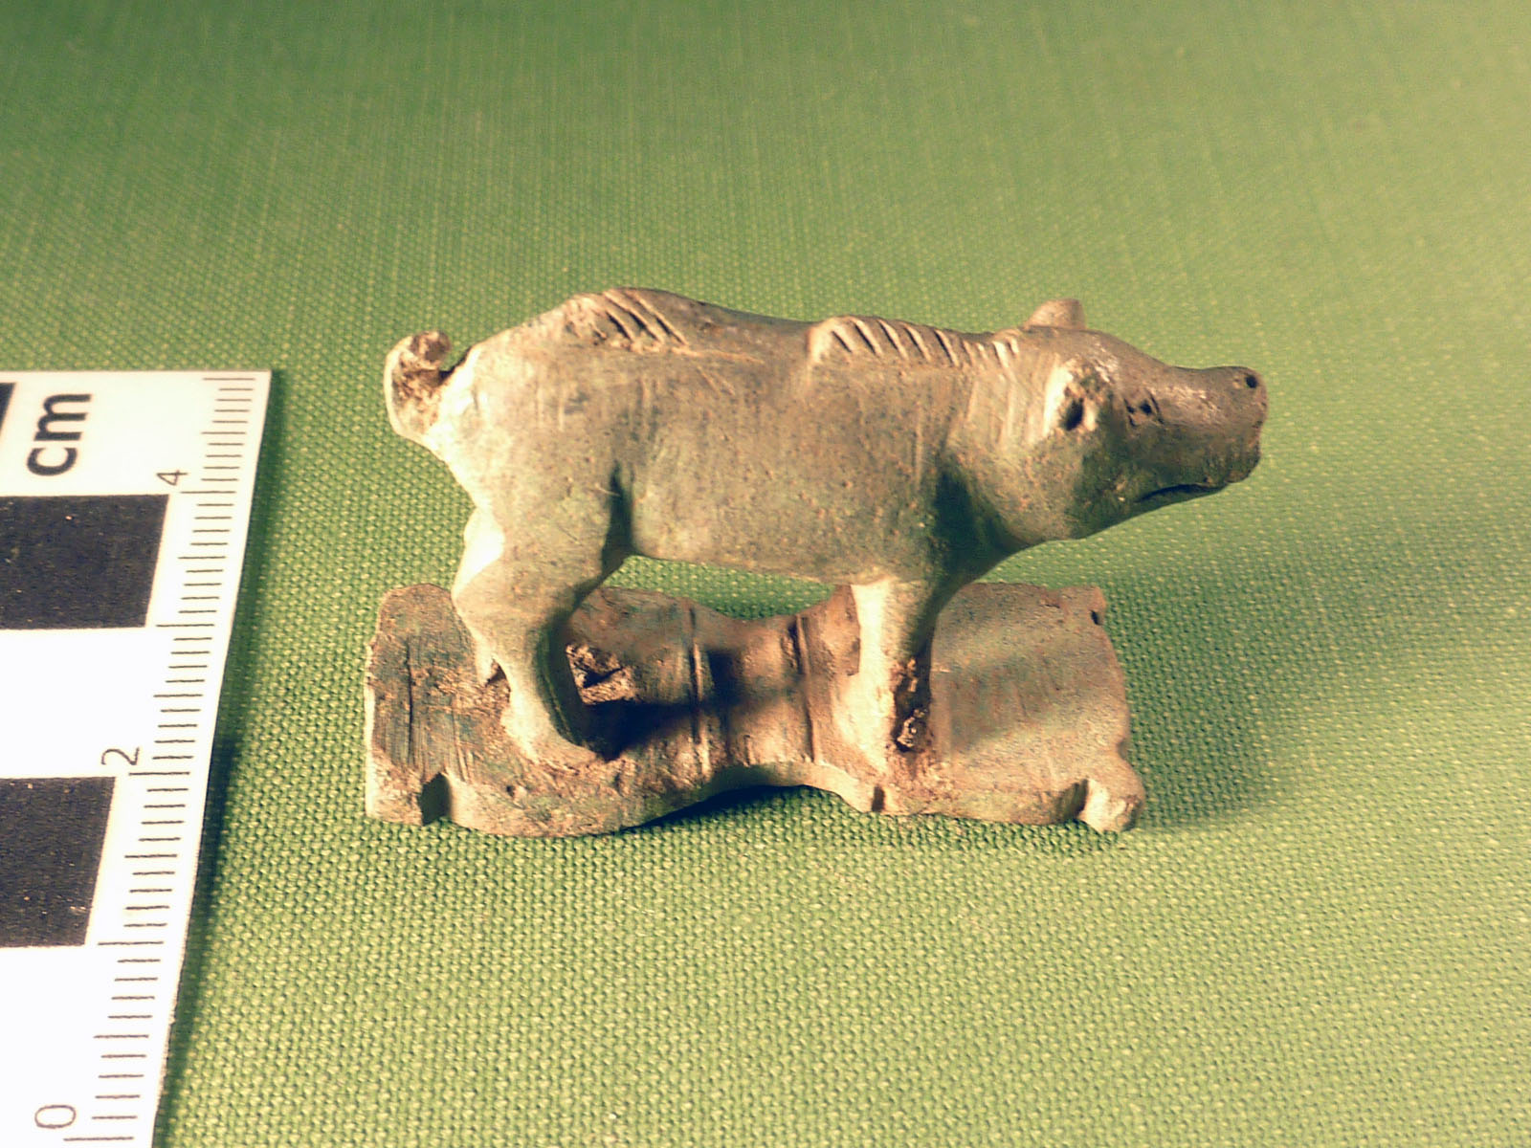
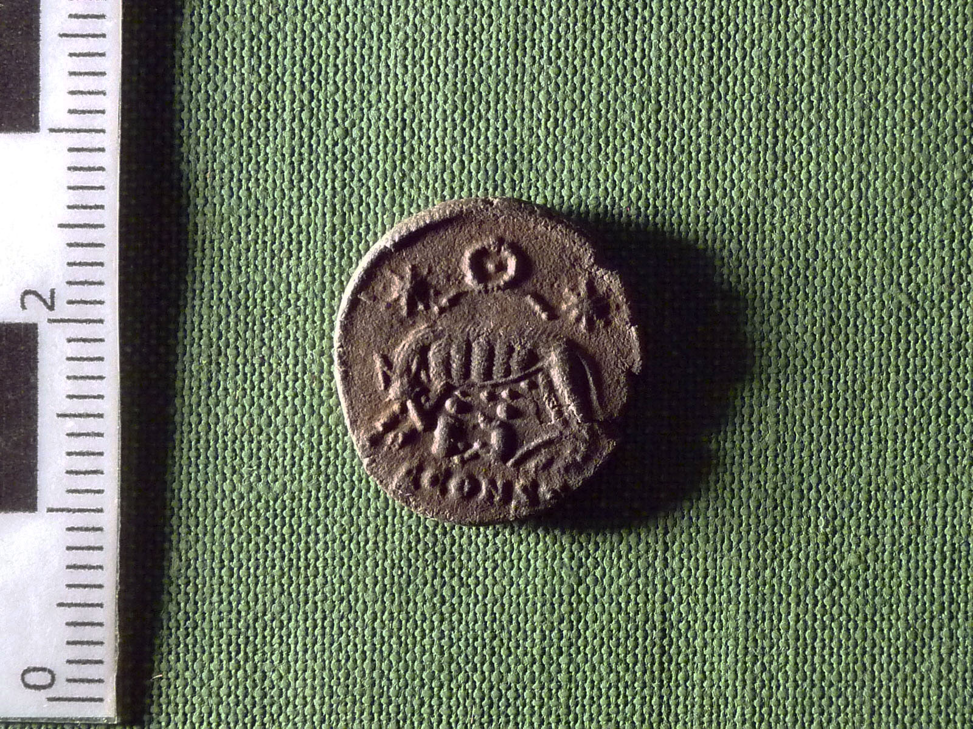
HEREFORD SEARCHERS
Hereford Searchers are a friendly metal detecting club
who search local farms and record their finds for posterity.
The club raises money for charity through its detecting rallies.

Slide 38
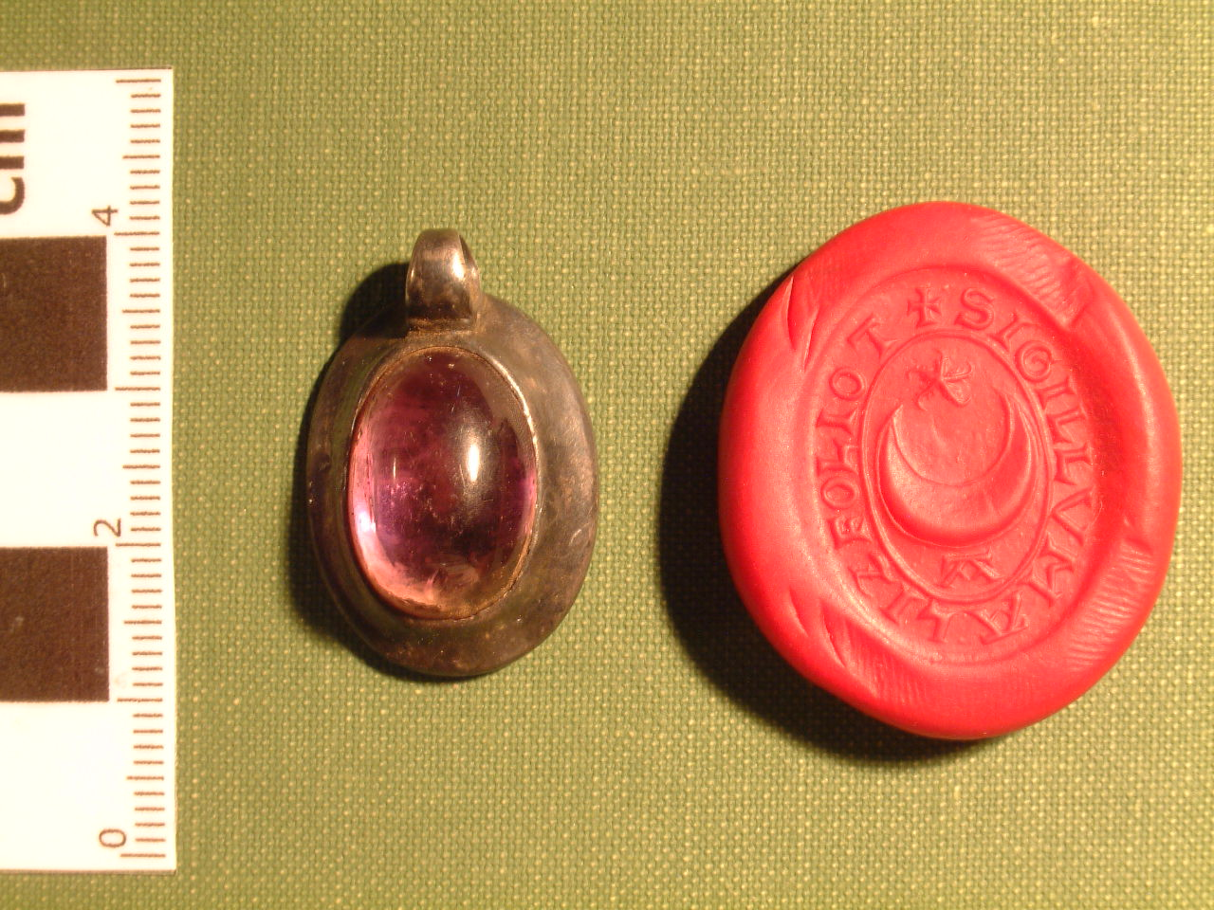
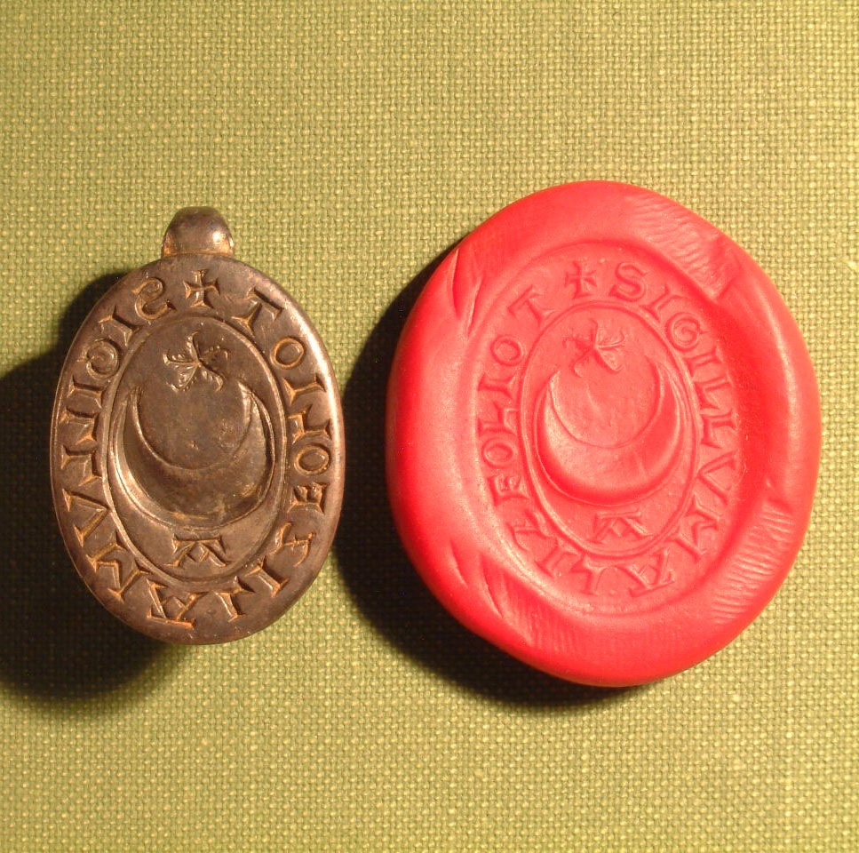
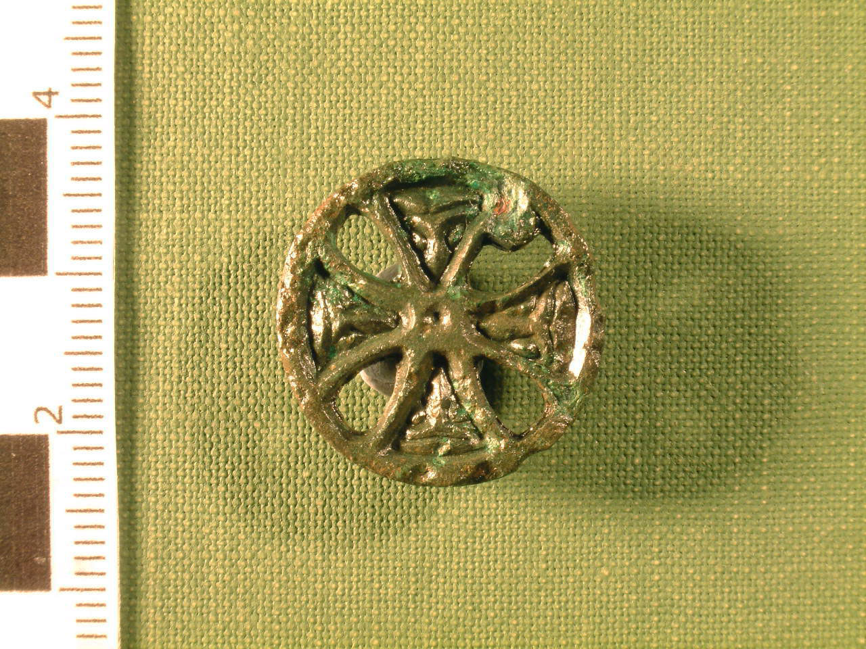
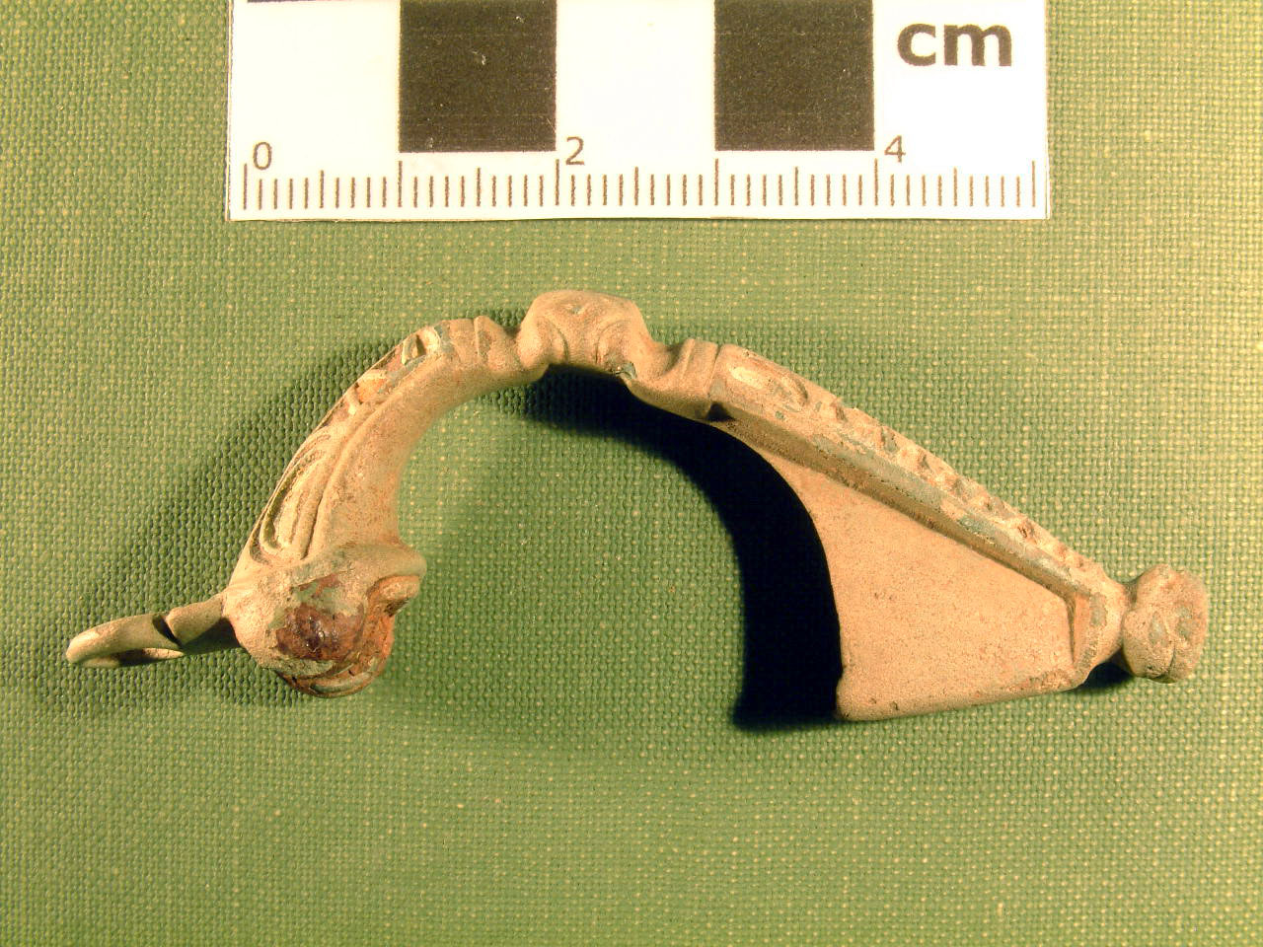
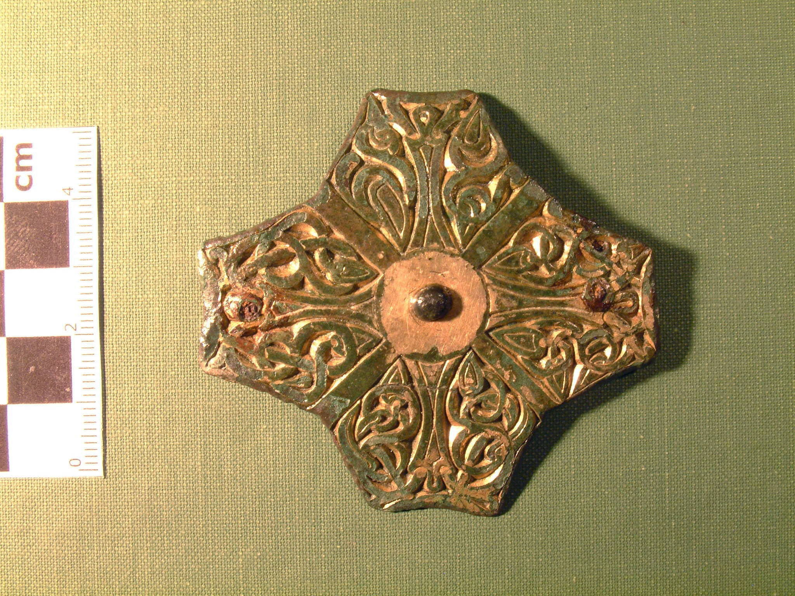
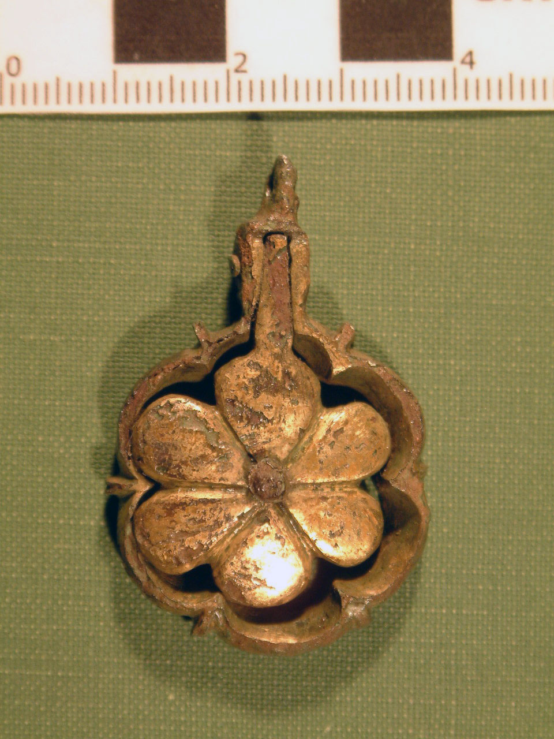
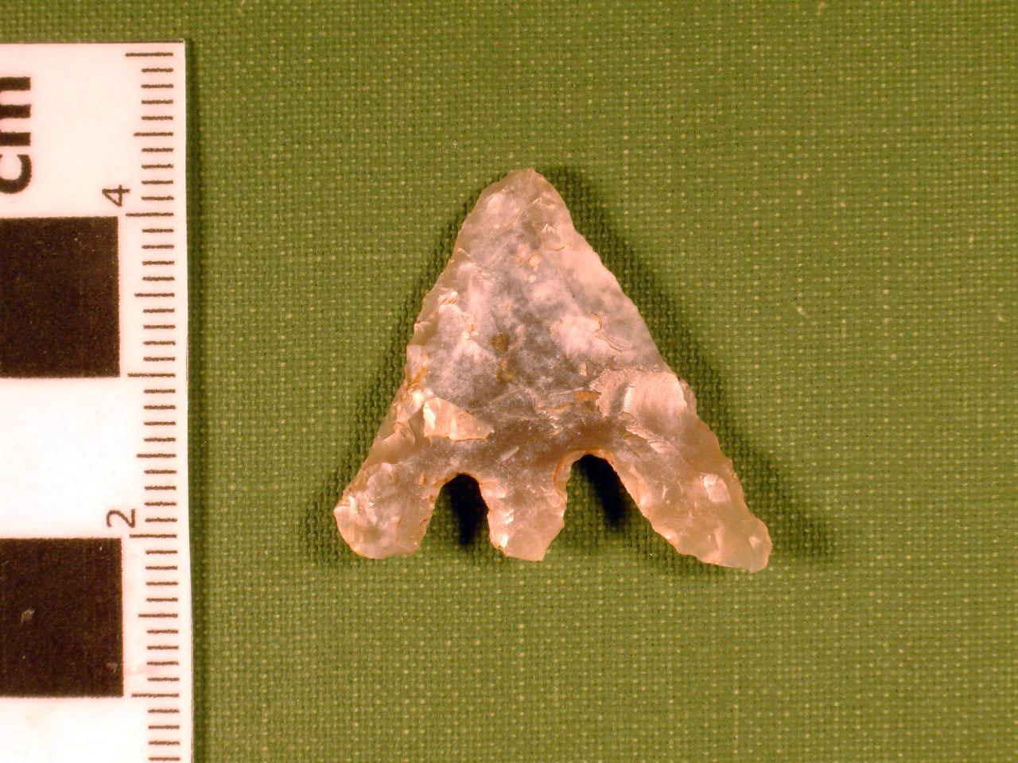
HEREFORD SEARCHERS
Lovely but small.
Not easy to find!

Slide 39
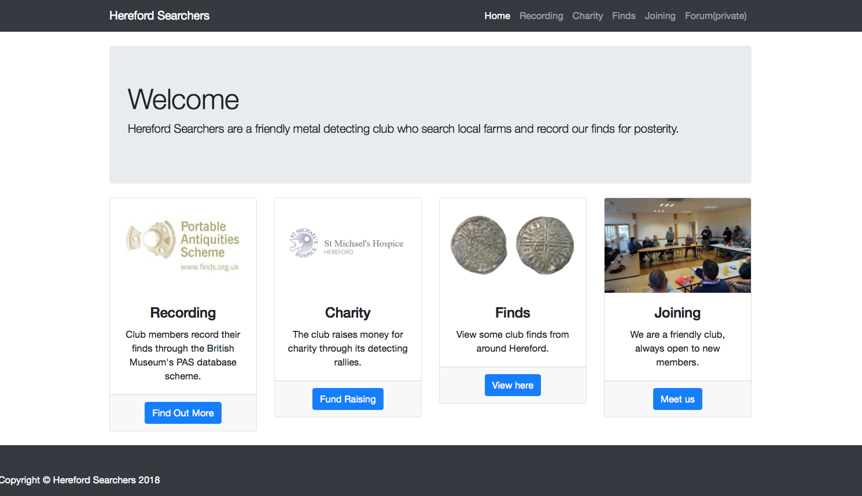
To find out more about HEREFORD SEARCHERS
visit www.herefordsearchers.co.uk

Slide 40
GOLDEN VALLEY GROUPS INITIATIVE - ROLLING PRESENTATION
A SELECTION OF PHOTOS & REPORTS
FEATURING SOME OF THE COMMUNITY GROUPS
WHO OPERATE IN AND AROUND THE GOLDEN VALLEY
GOLDEN VALLEY PROBUS CLUB
COMMUNITY FIRST
LET’S MOVE!
DORE COMMUNITY TRANSPORT
HEALTHWATCH HEREFORDSHIRE
FRIENDS OF THE ABBEY
HEREFORD SEARCHERS
GOLDEN VALLEY BOWLS CLUB – NEXT
PETERCHURCH HUB

Slide 41

GOLDEN VALLEY SHORT MAT BOWLS CLUB

Slide 42

GOLDEN VALLEY BOWLS CLUB

Slide 43
GOLDEN VALLEY BOWLS CLUB
Every Monday 10.30am-12.30pm
Every Tuesday 7.00pm-9.00pm
at
Ewyas Harold Memorial Hall
Everyone welcome – Novice or (not too) Expert

Slide 44
GOLDEN VALLEY GROUPS INITIATIVE - ROLLING PRESENTATION
A SELECTION OF PHOTOS & REPORTS
FEATURING SOME OF THE COMMUNITY GROUPS
WHO OPERATE IN AND AROUND THE GOLDEN VALLEY
GOLDEN VALLEY PROBUS CLUB
COMMUNITY FIRST
LET’S MOVE!
DORE COMMUNITY TRANSPORT
HEALTHWATCH HEREFORDSHIRE
FRIENDS OF THE ABBEY
HEREFORD SEARCHERS
GOLDEN VALLEY BOWLS CLUB
PETERCHURCH HUB - NEXT

Slide 45


Slide 46


Slide 47

To find out more about The Peterchurch Hub visit www.hubcommunity.org

Slide 48
GOLDEN VALLEY GROUPS INITIATIVE - ROLLING PRESENTATION
A SELECTION OF PHOTOS & REPORTS
FEATURING SOME OF THE COMMUNITY GROUPS
WHO OPERATE IN AND AROUND THE GOLDEN VALLEY
GOLDEN VALLEY PROBUS CLUB (10)
COMMUNITY FIRST (5)
LET’S MOVE! (3)
DORE COMMUNITY TRANSPORT (5)
HEALTHWATCH HEREFORDSHIRE (1)
FRIENDS OF THE ABBEY (4)
HEREFORD SEARCHERS (3)
GOLDEN VALLEY BOWLS CLUB (3)
PETERCHURCH HUB (3)

Slide 49

Please do not forget our own web site at www.GoldenValleyGroups.UK

Slide 50

GOLDEN VALLEY GROUPS INITIATIVE
Back to the beginning …

